Slide 1

A Presentation
Presenter

Slide 2
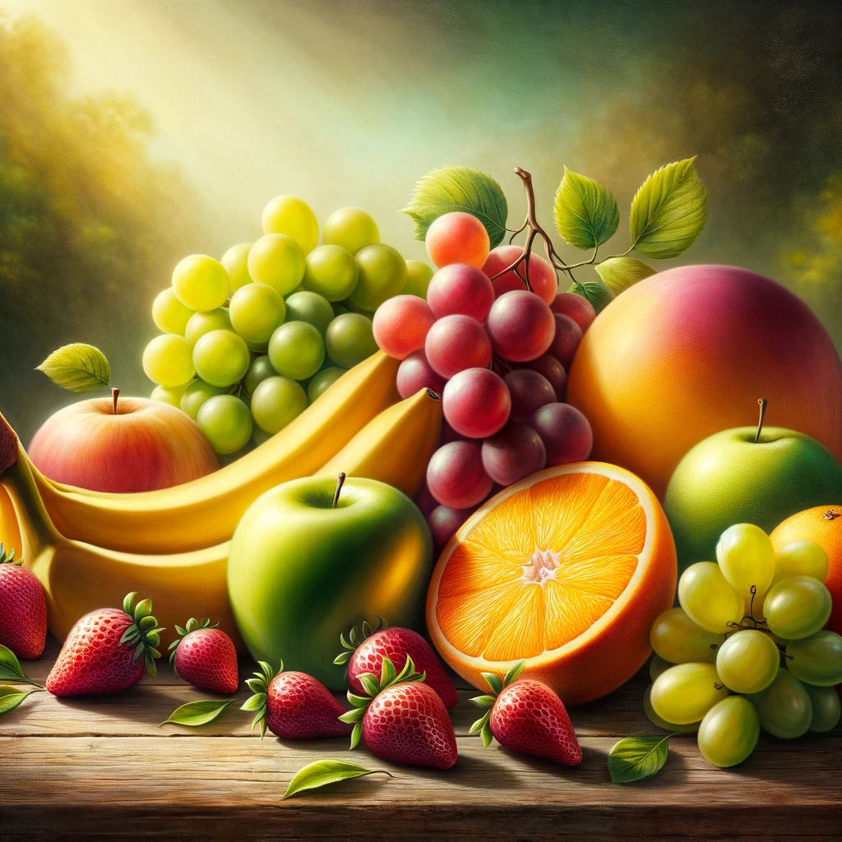
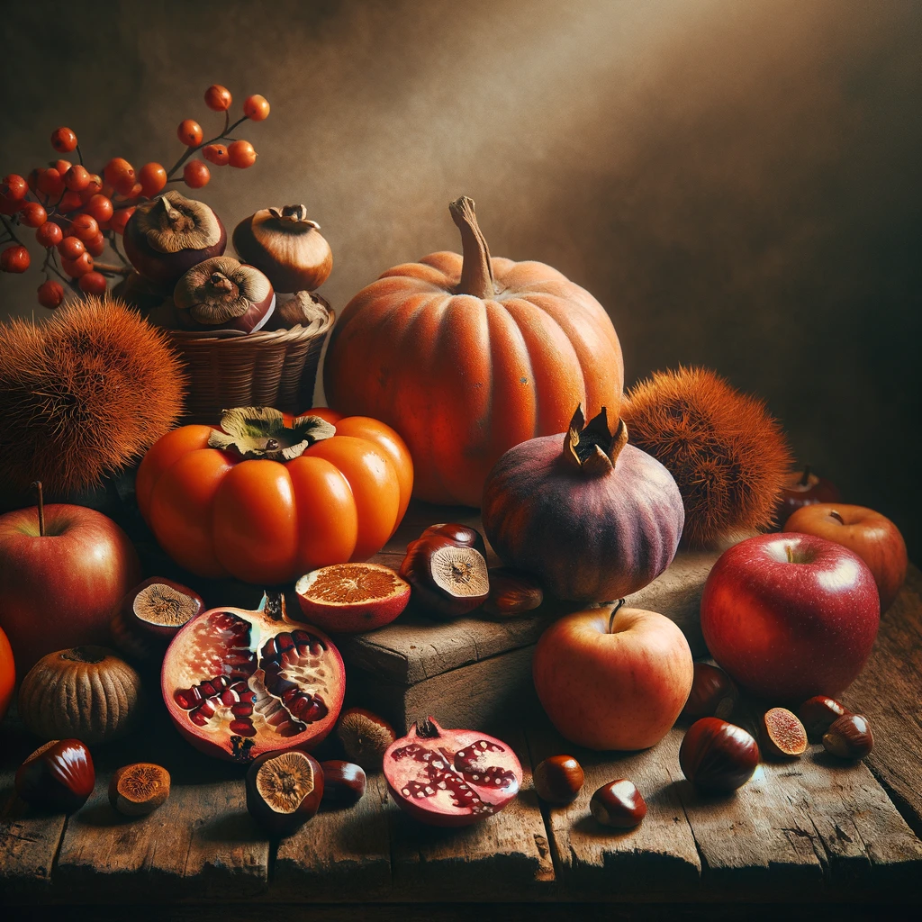
Fruits
DALL-E 3

Slide 3
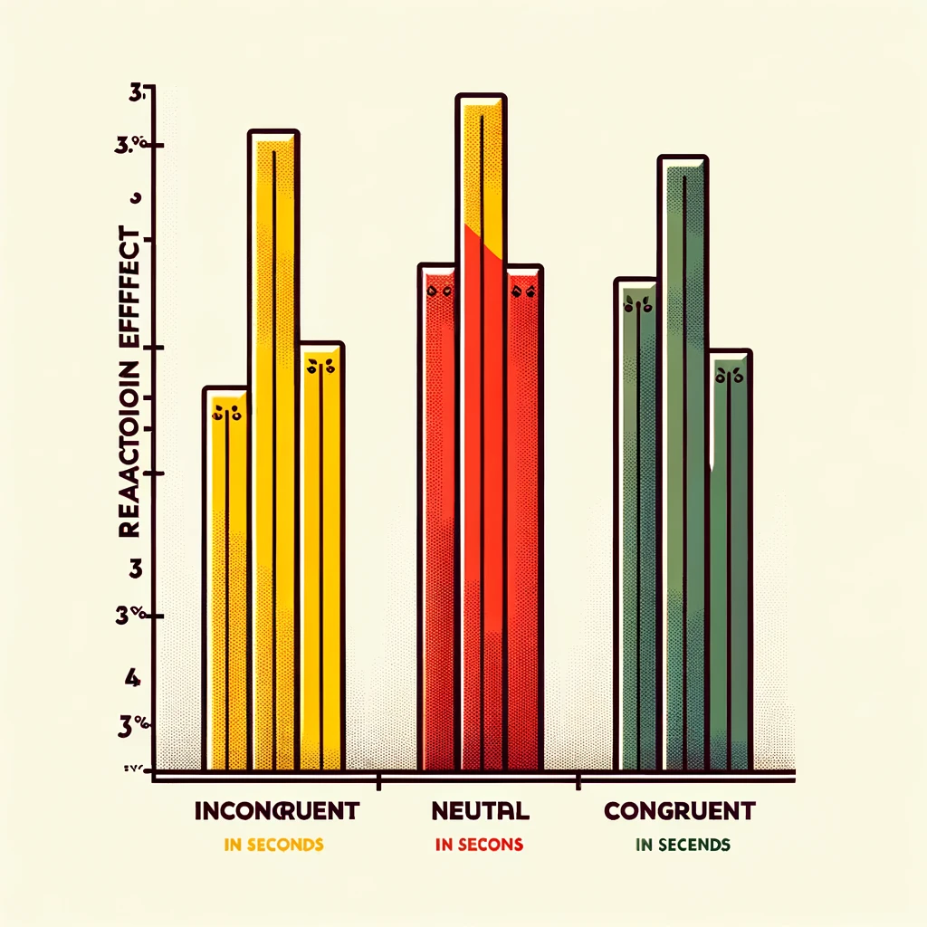
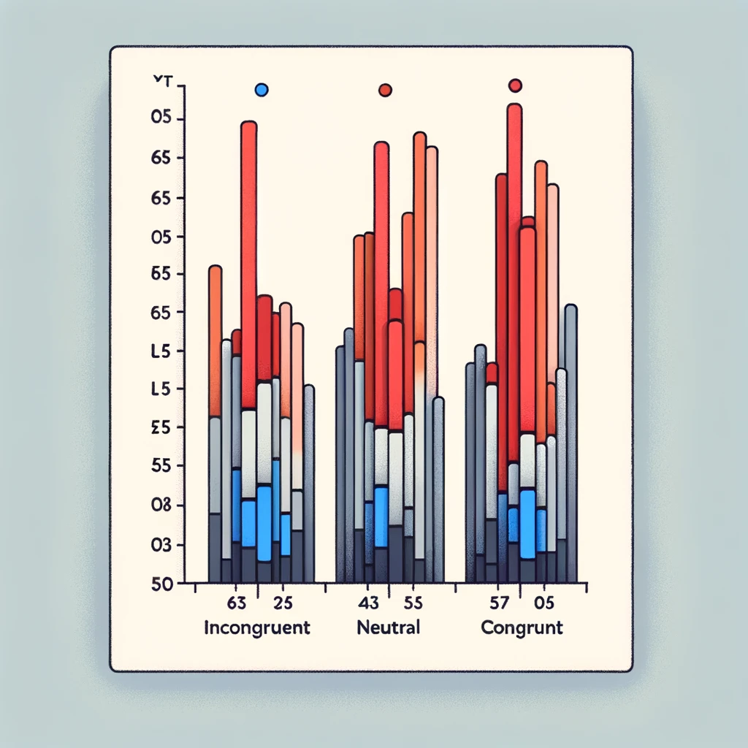
Graphs (grouped)
DALL-E 3

Slide 4



Shaped grouped

Slide 5
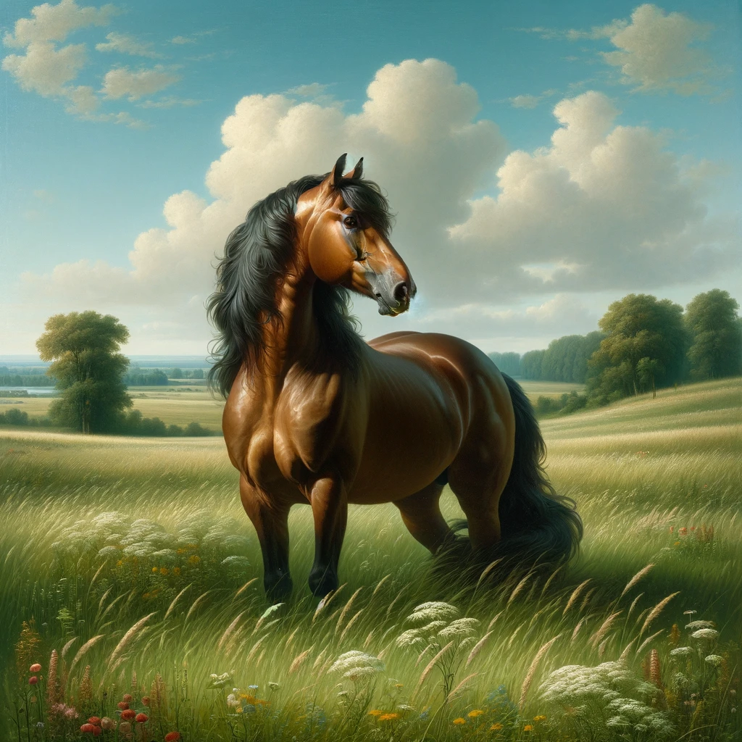
Image and text grouped
DALL-E 3

Slide 6
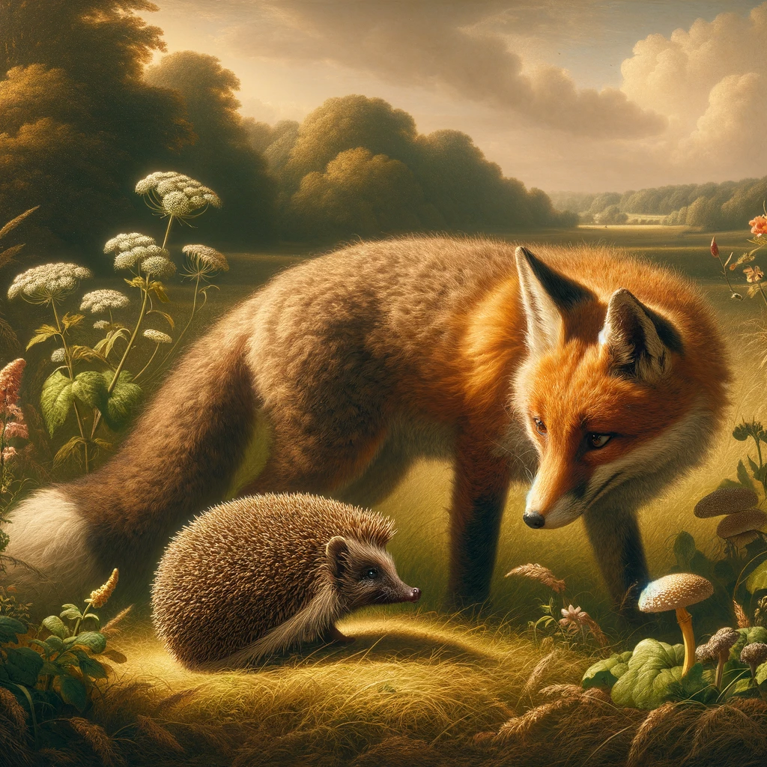
Slide
DALL-E 3

Slide 7
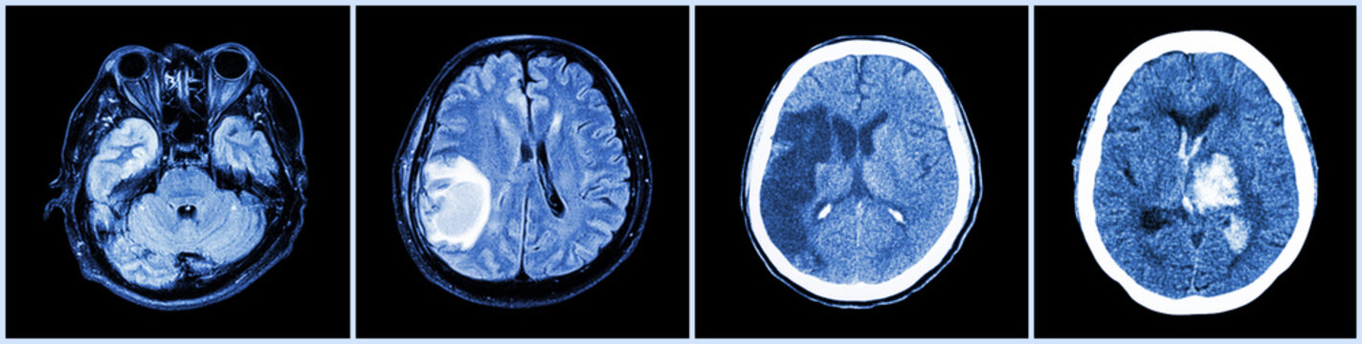
Brain CT scan. This is bad

Slide 8
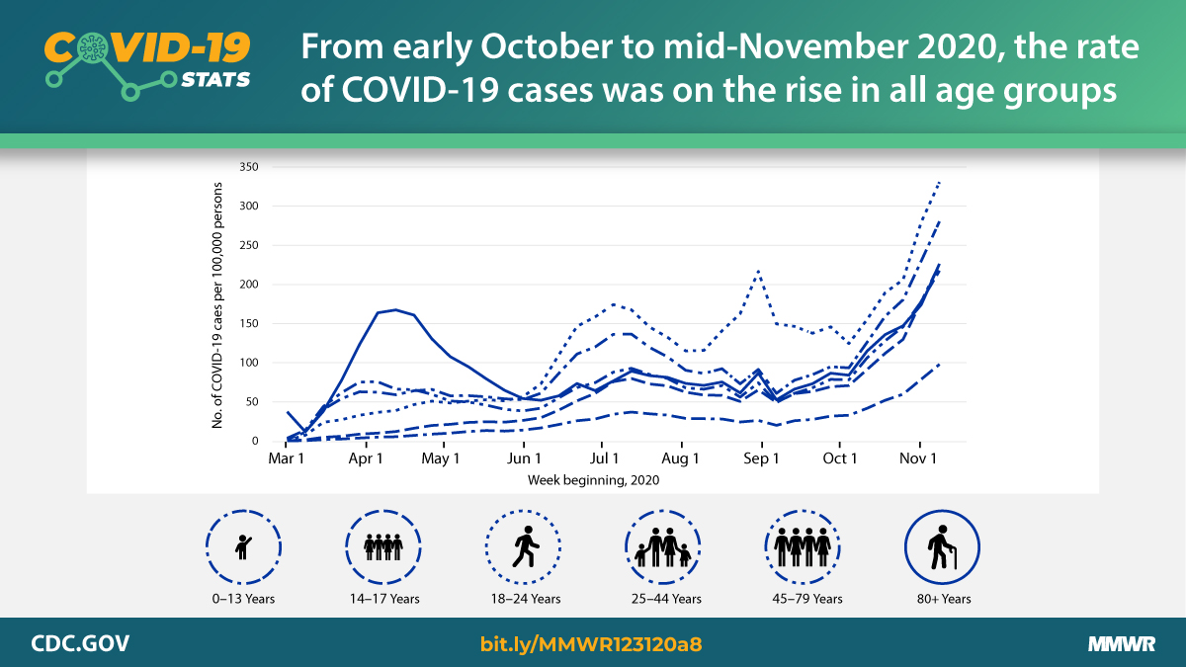

Slide 9
